Slide 1
Lecture 4 Context-free languages
Context-free languages
ambiguity
Chomsky Normal forms, and
simplifying algorithm

Slide 2
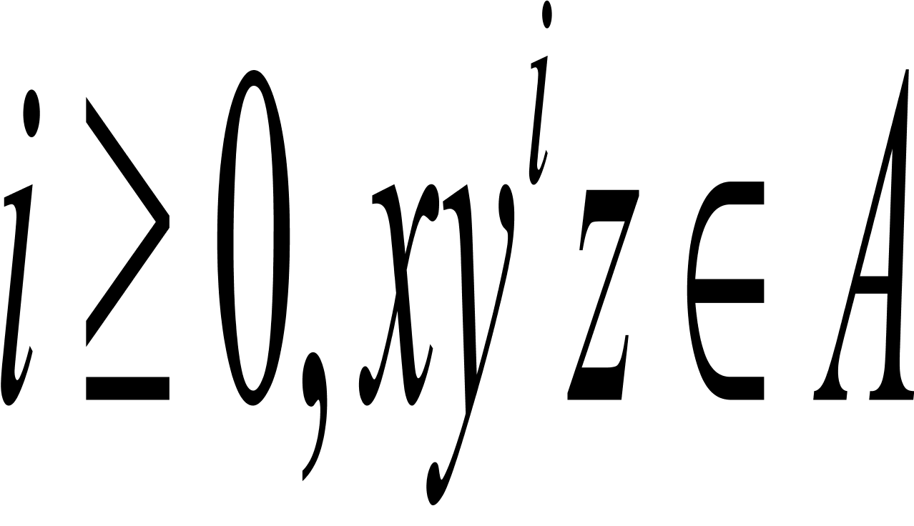
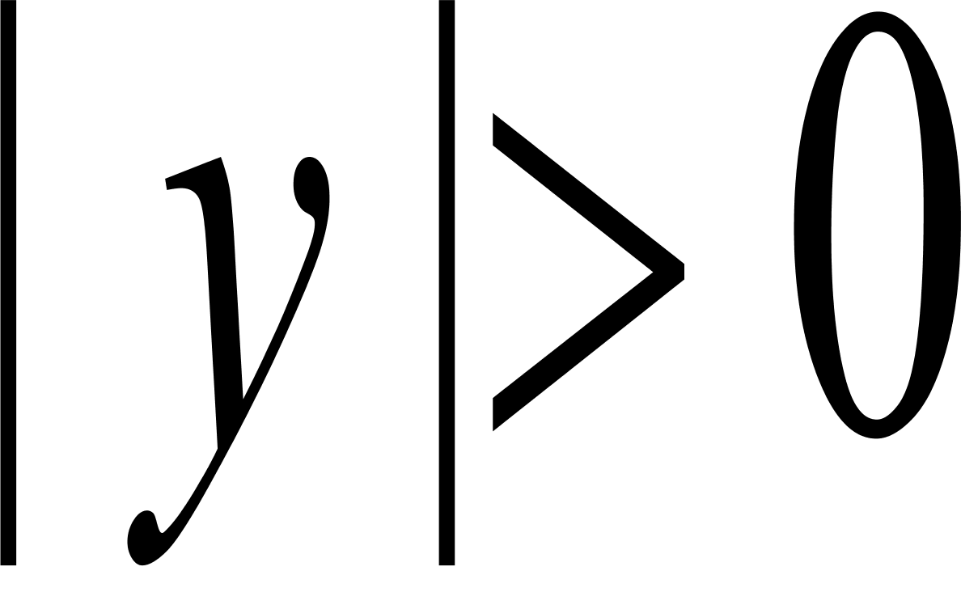
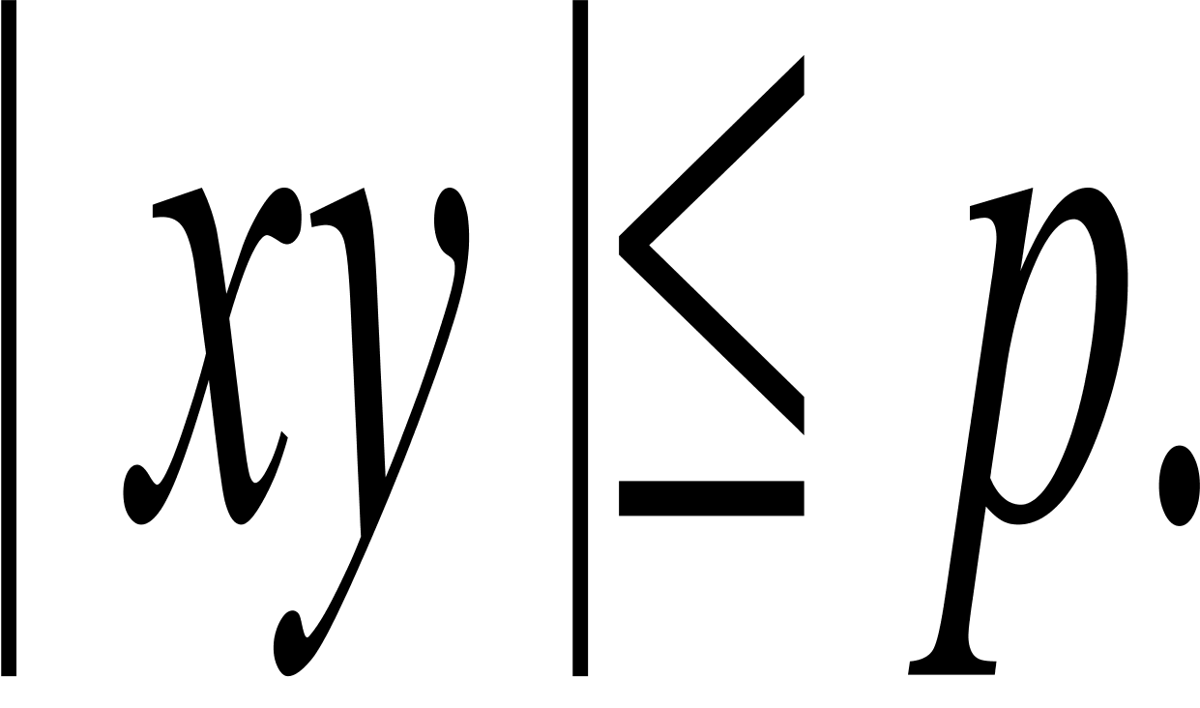
Pumping Lemma: necessary cond.
Negative results delineate the limits of computations!
If A is a regular language, then there is a number p (the pumping length) where, if s is any string in A of length at least p, then s may be divided into three pieces, s=xyz, satisfying the following conditions:
For each
, and
.

Slide 3
Proof Idea
s=s1 s2 s3 s4 s5 s6….sn string in A
q1 q3 q20 q9 q17 q9 q13 state
P is the number of states
y
x
q9
q1
z
q13
q9 is the first state that repeats

Slide 4
Proof steps
Proof by contradiction: B is nonregular
First assume the language B is regular and apply the pumping lemma to obtain the pumping length p
Next find a string s in B of length at least p which cannot be pumped.
Discuss s in several cases
So we arrive at a contradiction. Conclude that B is NOT regular

Slide 5
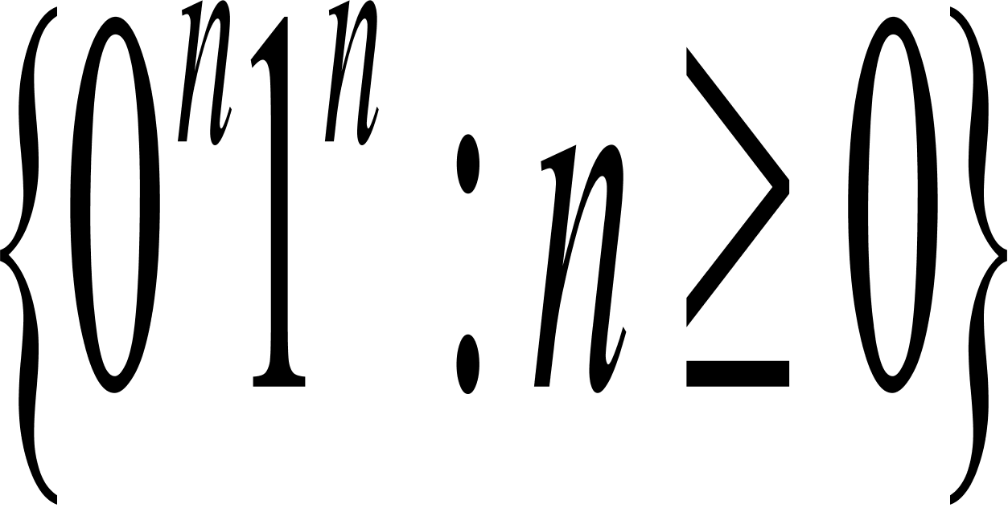
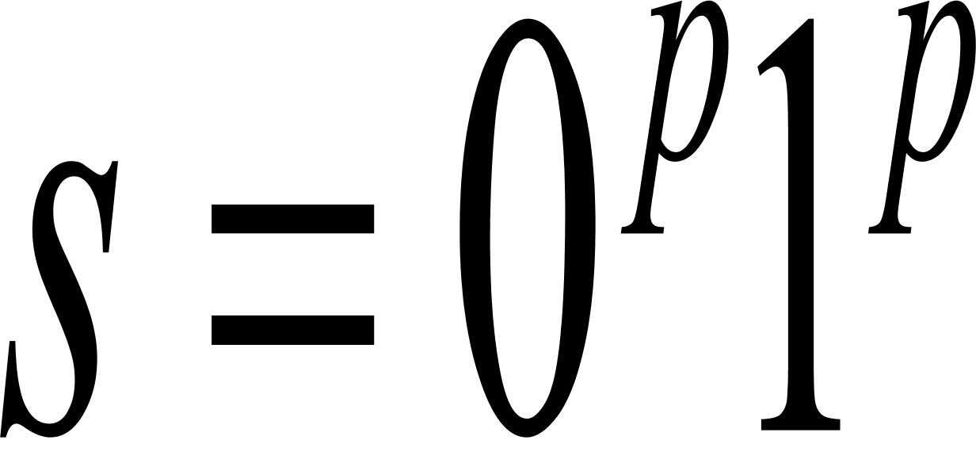
Example
Show that the language is not regular
Proof by contradiction: Suppose that it were regular. Let p be the pumping length given by the Pumping Lemma. Consider the string
y consists only of 0s;
Y consists only of 1s;
Y consists of both 0s and 1s.
We arrive at a contradiction. So it is not regular.
Discuss in cases

Slide 6

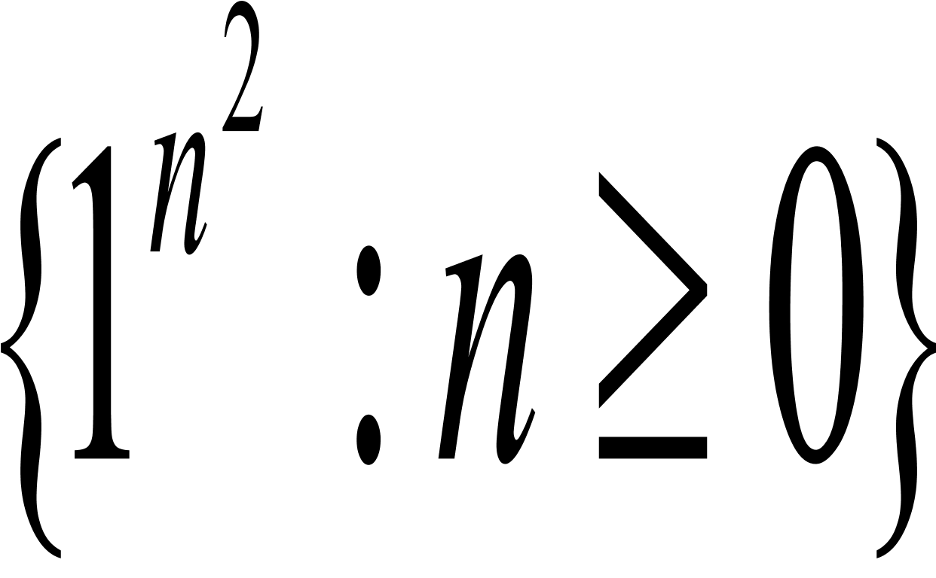
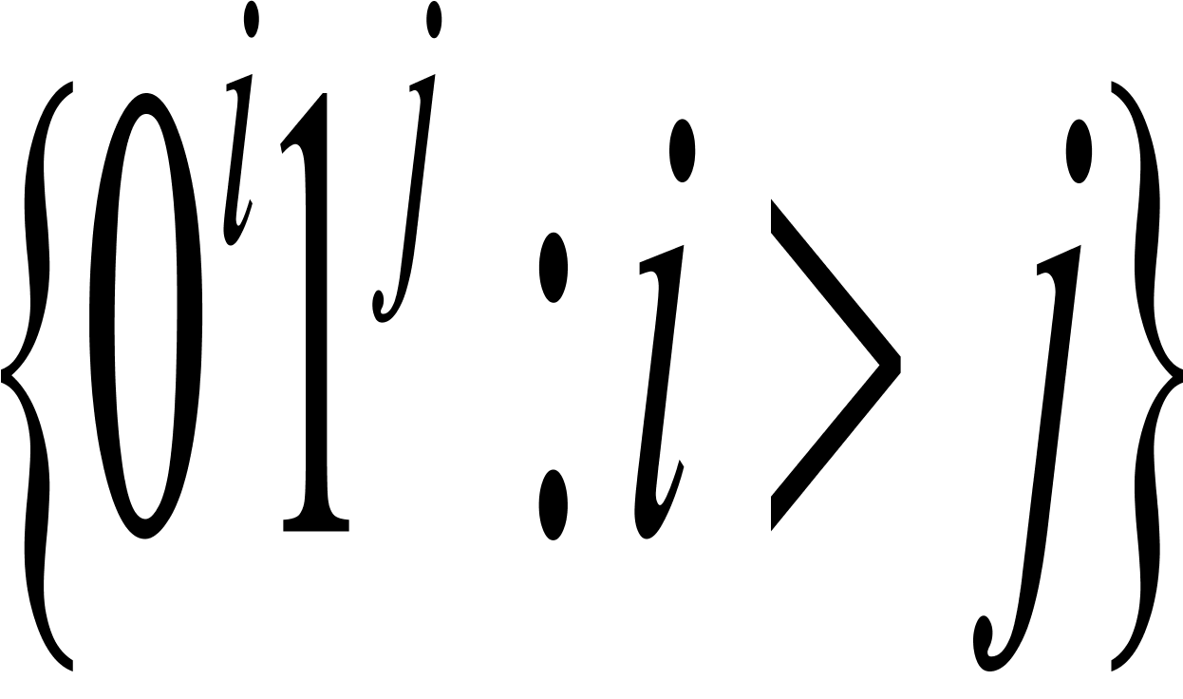
More examples
Prove that the following languages are not regular:
C={w|w has an equal number of 0s and 1s}.
F =
D =
E=

Slide 7
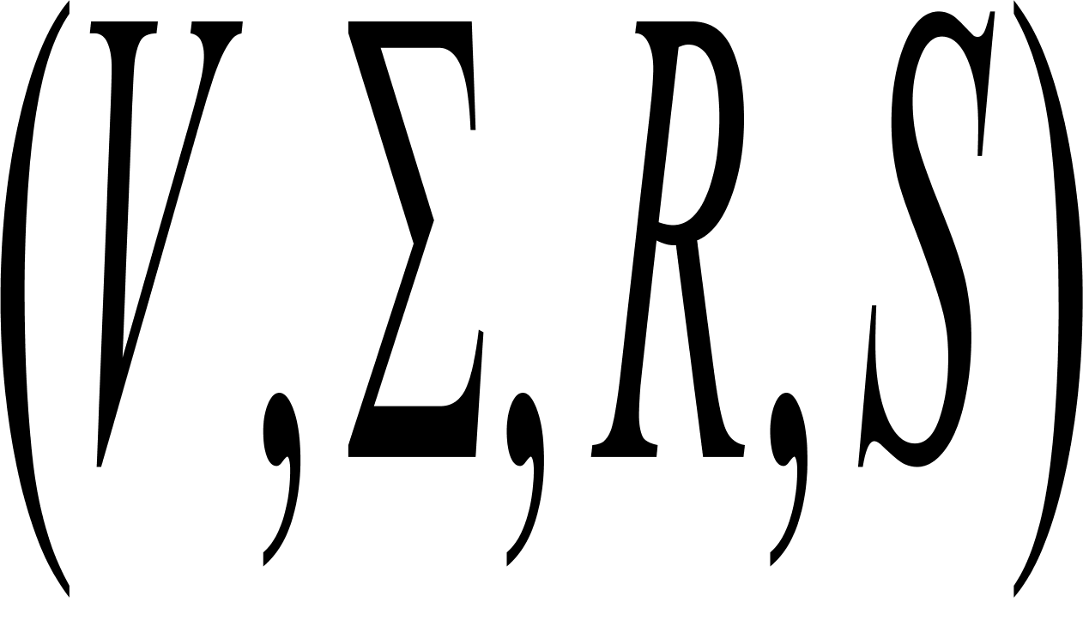

Context free languages
A context free grammar is 4 tuple
where
V is a finite set called the variables,
is a finite set, disjoint from V, called the terminals;
R is a finite set of rules, with each rule being a variable and a string of variables and terminals, and
S is the start variable.

Slide 8
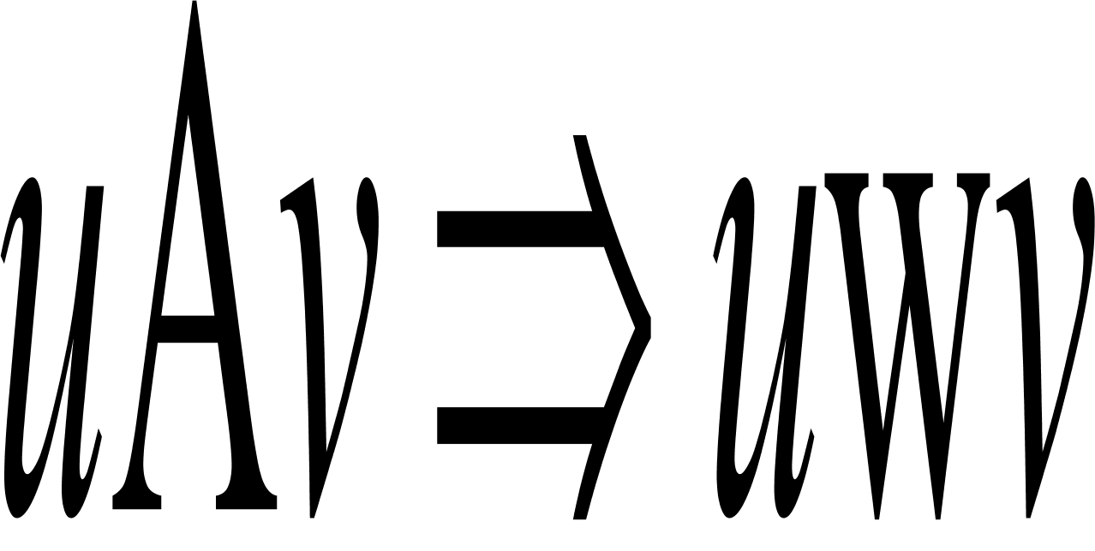
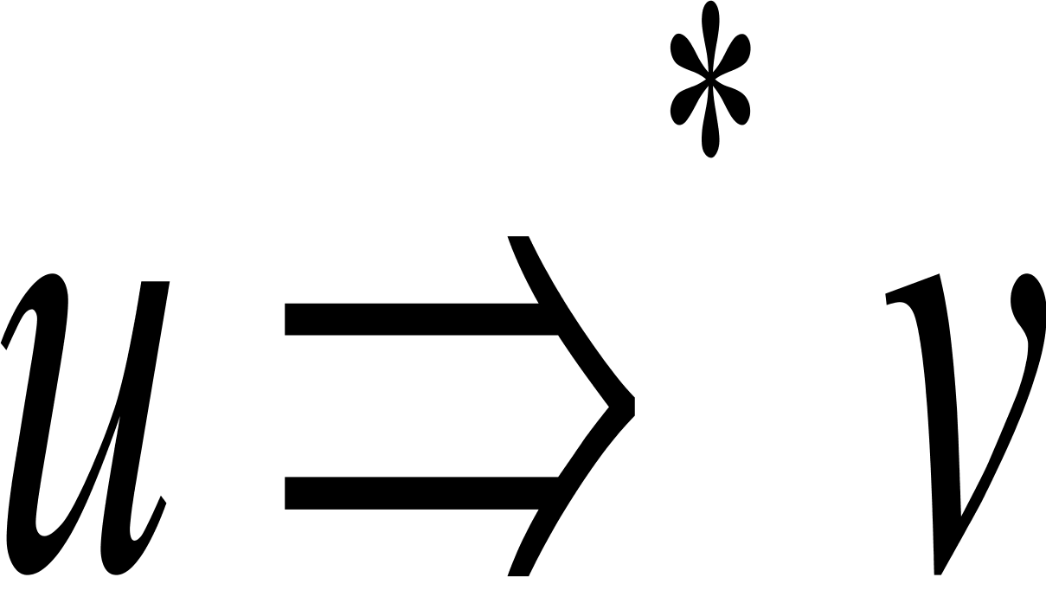
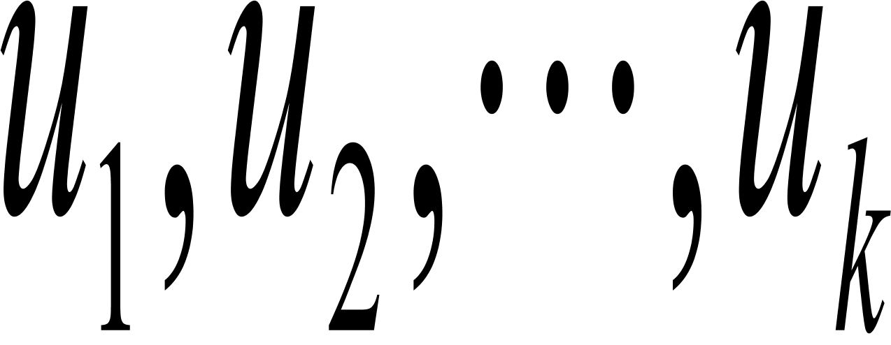
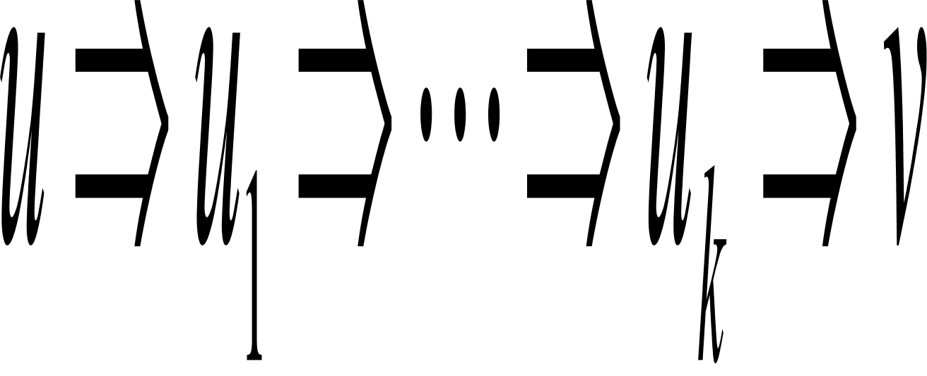
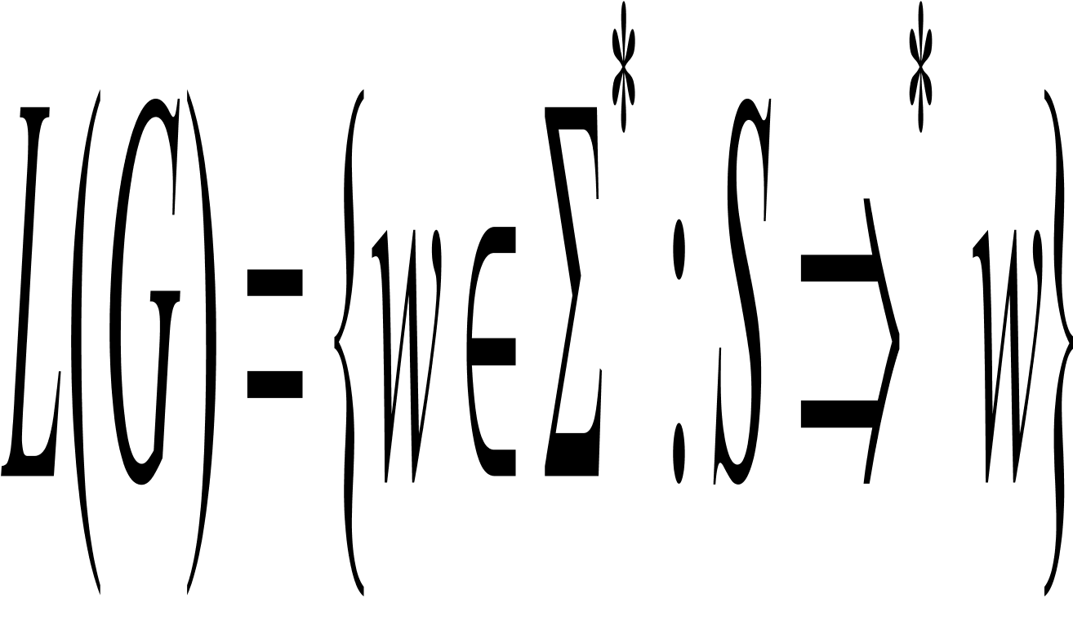
Derivation
If u, v and w are strings of variables and terminals, and A w is a rule of the grammar, we say that
a derivation step .
if u=v or if a sequence exists for k>=0 and
The language of the grammar is
Derivation is similar to deductive proof.

Slide 9

Examples
Consider grammar G3=({S},{a,b}, R,S). The set of rules, R, is S aSb|SS|
A 0A1
A B
B #
A
A
A
A
B
0
0
0
#
1
1
1
Parse tree

Slide 10

Examples
Consider grammar G4=(V, A, R, <EXPR>).
V is {<EXPR>, <TERM>,<FACTOR>} and A is {a, +, ,() }. The rules are
<EXPR> <EXPR>+<TERM>|<TERM>
<TERM> <TERM> <FACTOR>|<FACTOR>
<FACTOR> (<EXPR>)|a
Construct the parse tree for the strings a+a a, (a+a) a

Slide 11
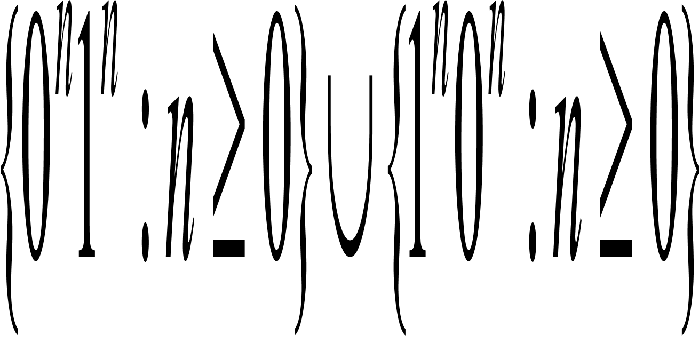
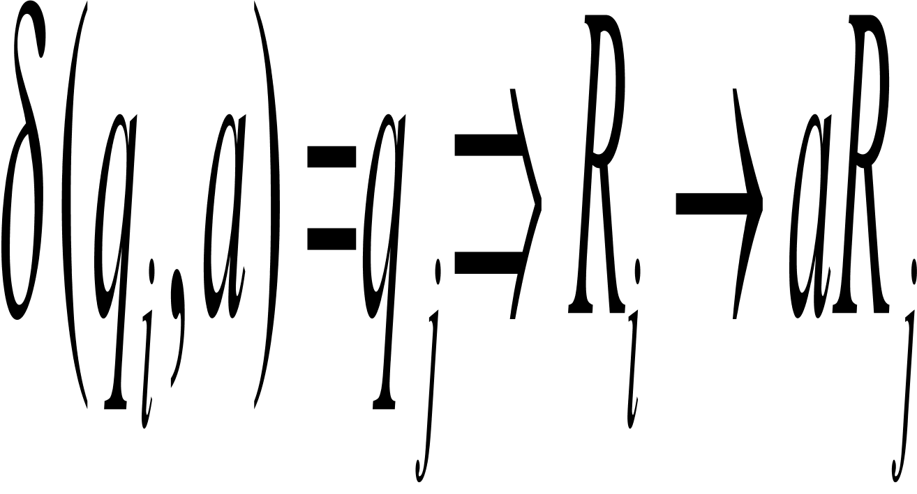
Designing CFGs: Techniques
Divide into simple pieces and putting together all rules for individual grammars by adding the new rule:
S S1|S2|S3…|Sk. Consider the following language
Convert a DFA into an equivalent CFG
And more? How can we prove this?

Slide 12
Examples: Two equivalent DFAs
0
1
How about NFAs?
start
A
1
B
0
start
C
0
D
0
0
1
1
E
1

Slide 13
Designing CFGs: techiques
Certain context languages contain strings with two substrings that are “linked” in the sense that a machine for such a language would need to remember an unbounded amount of information about one of the substrings to verify that it corresponds properly to the other substring. For example,
In more complex languages, the strings may contain certain structures that appear recursively as part of other (or the same) structure. Consider G4.

Slide 14
Examples
Give CFGs that generate the following languages
{w: w contains at least three 1s}
{w: w starts and ends with the same symbol}
The set of strings over the alphabet {a,b} with twice as many a’s as b’s

Slide 15
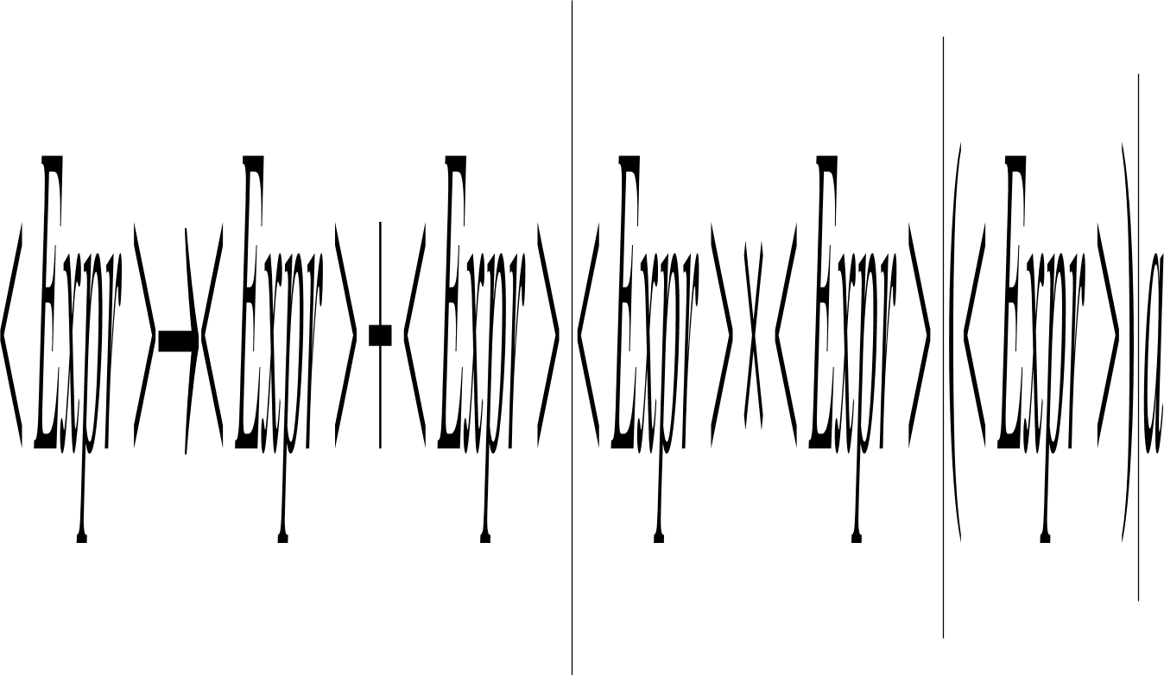
Example
Consider the grammar G5:
Expr
Parse Tree
Expr
Expr
Expr
Expr
Expr
Expr
Expr
Expr
Expr
a
+
a
a
a
+
a
a

Slide 16
Leftmost derivation
A derivation of w in a grammar G is a leftmost derivation if at every step the left remaining variable is the one replaced.
Example: Give a CFG for the regular language 0*1(0+1)* and give a leftmost derivation of the string 00101.
Proposition: There is a one-to-one correspondence between
leftmost derivations and parse trees.

Slide 17
Ambiguity
A string w is derived ambiguously in context free grammar G if it has two or more different leftmost derivations.
Grammar G is ambiguous if it generates some string ambiguously.

Slide 18
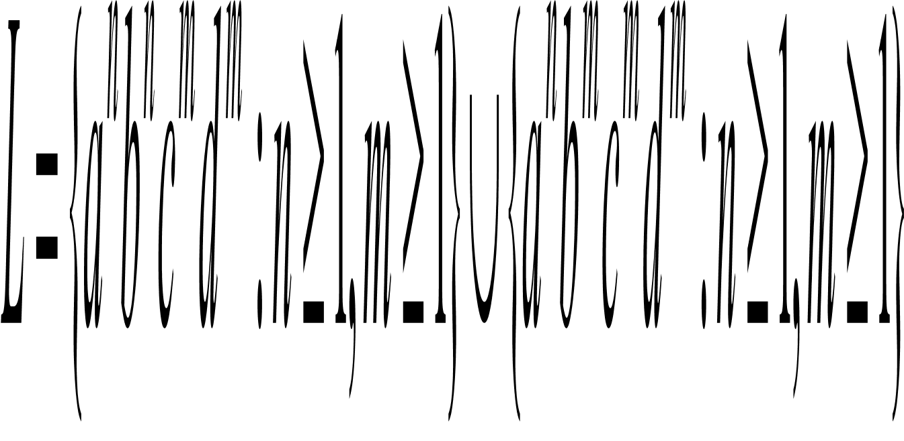
Ambiguity
There is no algorithm whatsoever that can tell us whether a CFG is ambiguous
There are CFLs that are inherently ambiguous. Consider the following language

Slide 19
Ambiguity
Two typical causes of ambiguity in grammar
The precedence of operators is not respected
A sequence of identical operators can group either from the left or from the right.
For example, a+a+a

Slide 20
Removing ambiguity
Introduce several different variables, each of which represents those expressions that share a level of “binding strength”
Factor: identifier, parenthesized expression
Term
Expression
Example: G5

Slide 21
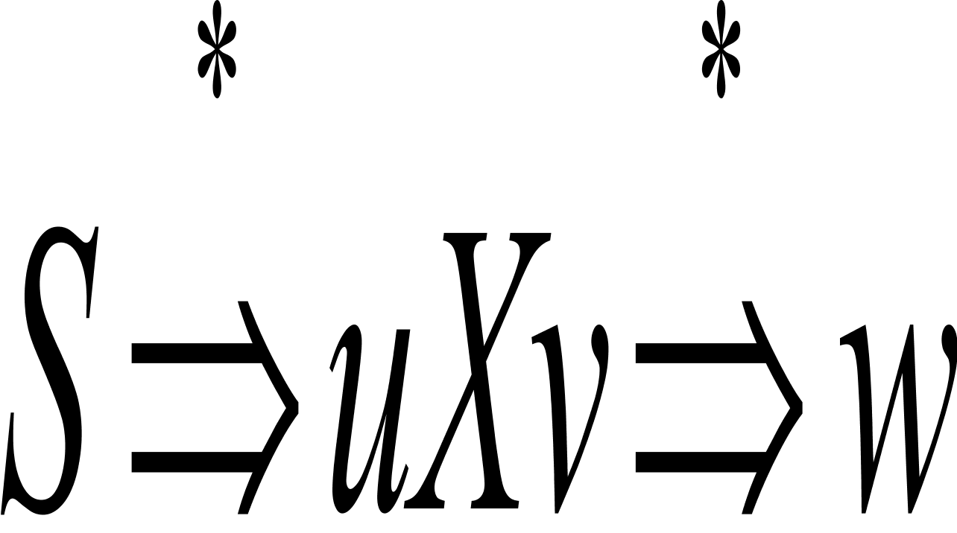
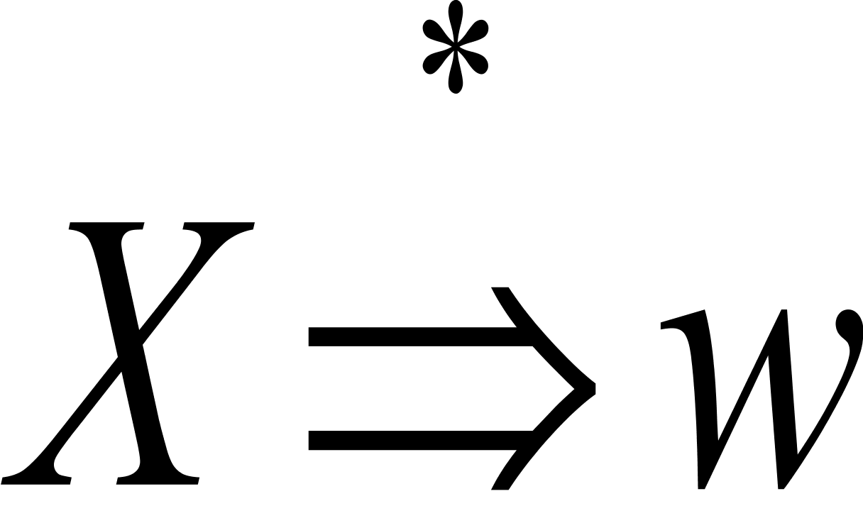
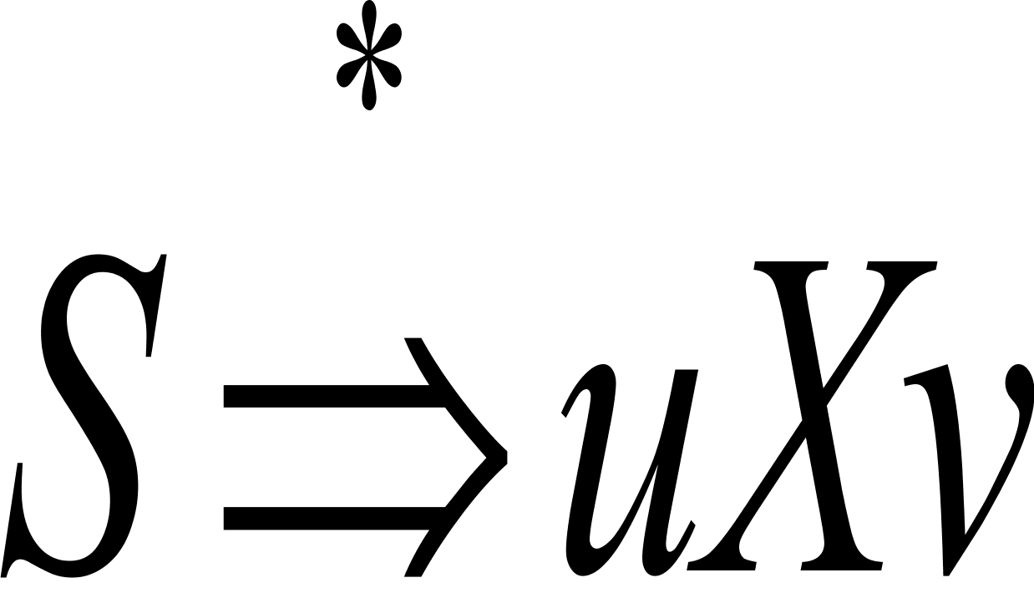
Useful symbols
A symbol X is useful for a CFG G=(V,T, R,S) if there is some derivation of the form
where w is in T*.
X is generating if for some terminal string w.
X is reachable if there is a derivation for some strings u and v.
Consider: S-> AB|a
A->b

Slide 22
Eliminating useless symbols
Theorem: Let G=(V,T,P,S) be a CFG and L(G) is not empty. If G’ is the CFG obtained by the following two steps (in this order):
First eliminating nongenerating symbols and all rules involving one or more of those symbols;
secondly eliminating all nonreachable symbols
Then G’ has no useless symbols and L(G’)=L(G).

Slide 23
Computing the Generating and Reachable Symbols
Basis: Every terminal symbol is generating;
Induction: Suppose that there is a rule A -> u, and every symbol of u is known to be generating. Then A is generating.

Slide 24
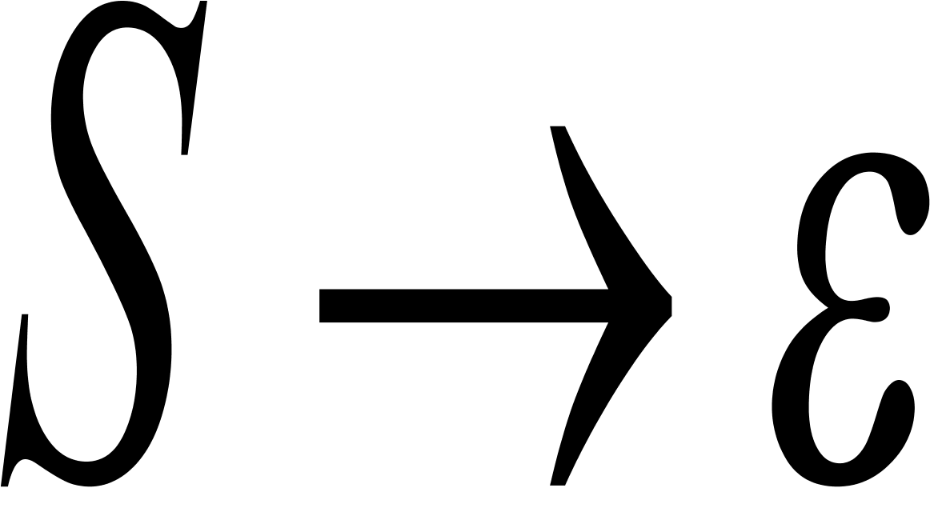
Chomsky Normal Form
A context free grammar is in Chomsky normal form if every rule is of the form
A BC
A a
where a is any terminal and A, B and C are any variables—except that B and C may not be the start variable. In addition, we permit the rule where S is the start variable.
What is the corresponding structure?

Slide 25
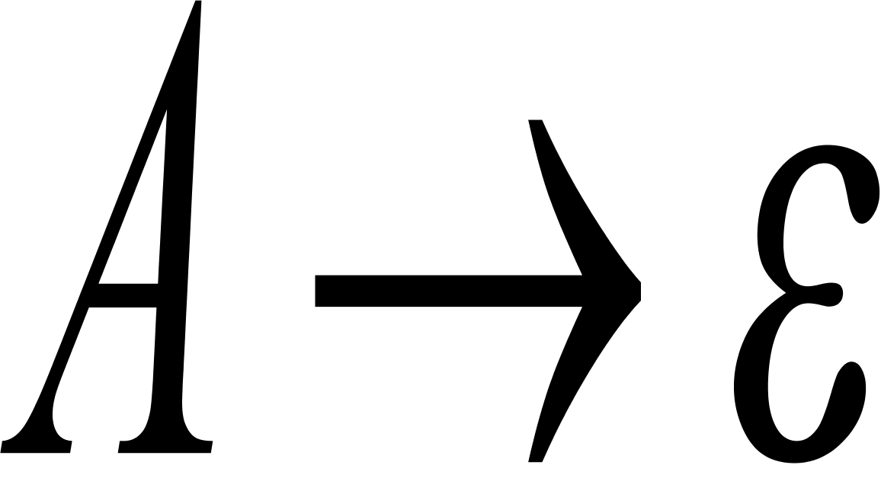
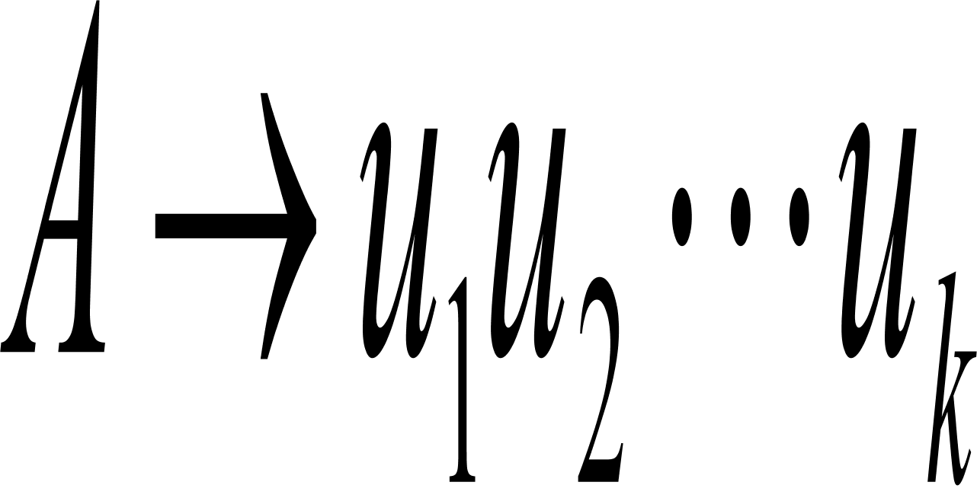
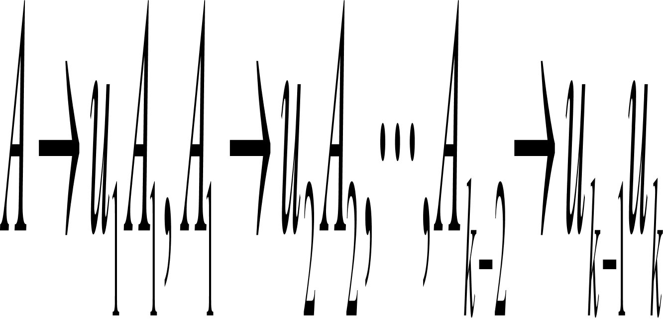
Convert CFGs into Chomsky normal forms
Any context free language is generated by context free grammar in Chomsky normal form.
Proof idea: The conversion consists of the following stages:
Add a new start symbol S0 and the rule S0 S
Eliminate all rules of the form
Eliminate all unit rules of the form A B.
Replace each rule with the rules

Slide 26
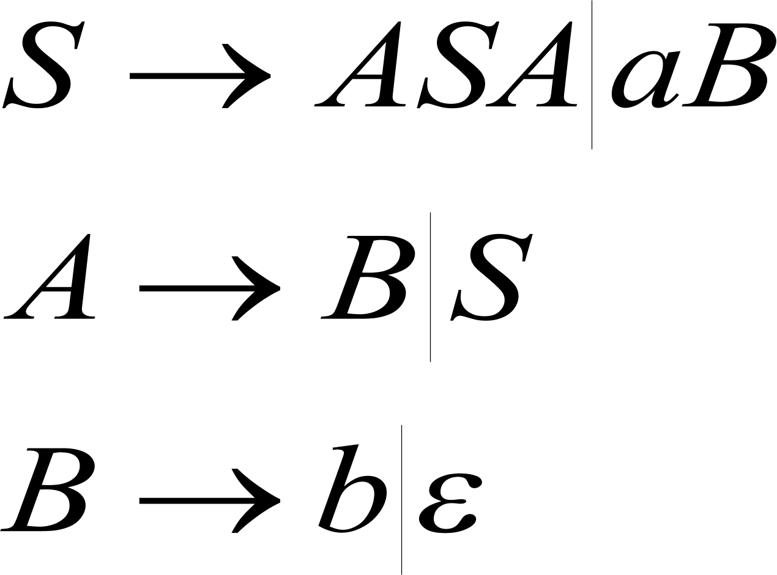
Example
Convert the following grammar G6 into Chomsky normal form

Slide 27
Order of the simplification
Firstly eliminate the epsilon-rules;
Secondly eliminate the unit rules;
Last eliminate useless symbols.
Exercises: Ex 2.6, 2.14

